Slide 1





Databases Advanced
Course Introduction
Databases Advanced
SoftUni Team
Technical Trainers
Software University
http://softuni.bg

Slide 2



Table of Contents
Course Overview
Trainers Team
Course Schedule
Exams and Evaluation
Learning Resources

Slide 3
Questions
sli.do #db-advanced

Slide 4







SoftUni Diamond Partners

Slide 5



Databases Advanced
Databases Advanced
Course Objectives & Program

Slide 6


Course Topics
The Databases Advanced course covers
Connecting to local DB instance
OOP Introduction for DB usage
ORM, Hibernate and Spring Data
Code-First implementations
Programming Patterns
Working with data in other formats (XML, JSON)

Slide 7
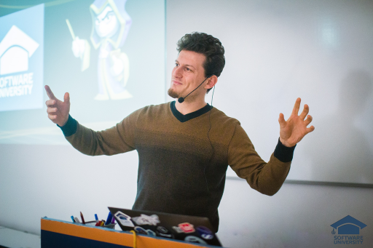
The Trainers Team

Slide 8

Trainers Team
Vasil Peevski
Technical Trainer @ Software University
Senior Java Developer
Interests in education platforms and personal development
Interests in Spring Framework, Hibernate Framework, Maven, Jersey, Jackson, GSon

Slide 9

Trainers Team (2)
Ivan Ivanov
Technical Trainer @ Software University
Top performing student from the Software University
Develops APIs and Libraries in his spare time
Interests in back-end web development, Spring, Vert.x and Java Technologies in general

Slide 10
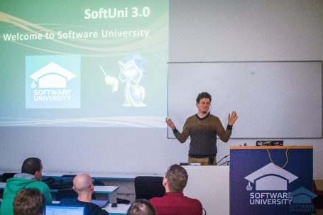


Databases Advanced
Course Details and Schedule

Slide 11
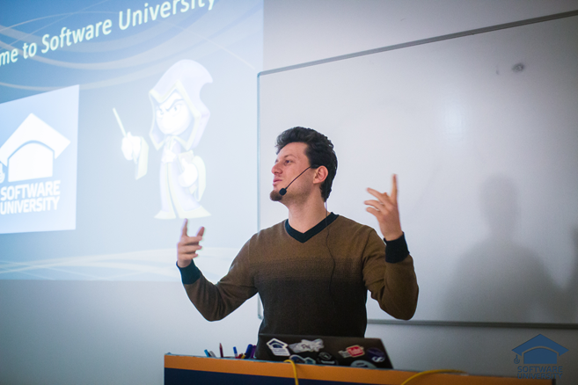
Training Duration and Schedule
Lessons: ~ 50 hours (onsite + YouTube videos)
Practical exercises (in class): ~ 60 hours
Homework: ~ 0-60 hours
Time frame
26-Jun-2017 – 13-Aug-2017

Slide 12


Why English?
Why are the slides in English?
English is the native language of the software engineers
Specific terminology should be in English
Translations are inaccurate and funny
Just learn English!
No excuses

Slide 13


Your RFID Chip
Students can either
Take RFID chip from SoftUni
Or use their own chip / card (125 KHz)
Register your chip number in your SoftUni profile: https://softuni.bg/users/profile/show
Check-in at the reception every time when you come in SoftUni
See your last visits in your profile: https://softuni.bg/users/profile/show

Slide 14


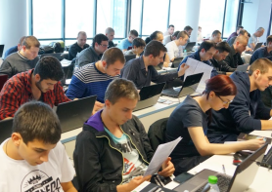
Databases Advanced
Evaluation Criteria

Slide 15


Scoring System for the Course
Mandatory:
Final exam – 90%
Exercises & Homework (+ Checks) – 10%
Bonuses:
Presence in class – 5% bonus
Forum activity – bonus up to 5%

Slide 16


Homework Assignments & Exercises
Course activities!
Lesson days → slides + live demos
Exercise days → only exercises
How to submit your homework?
Submitted on the course page in softuni.bg
Do your homework when it's due!
Assignments pile up quickly

Slide 17









Resources
What We Need Additionally?

Slide 18
Course Web Sites
The Databases advanced – Hibernate official web page:
https://softuni.bg/trainings/1635/databases-frameworks-hibernate-and-spring-data-june-2017

Slide 19

Forum
Register for the "Software University Forum":
Discuss the course exercises with your colleagues
Find solutions for all course exercises
Share source code / discuss ideas / help each other
http://softuni.bg/forum

Slide 20



The Databases Basics Slides and Videos
All lecture slides, videos, exercises, projects and other resources are open content, available for free
Visit the course web site to access the course resources

Slide 21



Recommended Software
Software needed for this course:
MySQL Server & Workbench | HeidiSQL https://dev.mysql.com/downloads/mysql/
IntelliJ IDEA – https://www.jetbrains.com/idea/?fromMenu

Slide 22
Introduction to Databases
https://softuni.bg/courses/databases-advanced-hibernate

Slide 23
License
This course (slides, examples, demos, videos, homework, etc.) is licensed under the "Creative Commons Attribution-NonCommercial-ShareAlike 4.0 International" license
Attribution: this work may contain portions from
"Fundamentals of Computer Programming with C#" book by Svetlin Nakov & Co. under CC-BY-SA license

Slide 24






Free Trainings @ Software University
Software University Foundation – softuni.org
Software University – High-Quality Education, Profession and Job for Software Developers
softuni.bg
Software University @ Facebook
facebook.com/SoftwareUniversity
Software University @ YouTube
youtube.com/SoftwareUniversity
Software University Forums – forum.softuni.bg

